Slide 1
Pre-Calc & Trig
Day 54

Slide 2
Bell Work: Finish Quiz (10-15 minutes) Additional Questions?

Slide 3
Things to Study for the Test
Level 2
Use SOH-CAH-TOA Use Calculator to Estimate Trig Functions Solve the Triangle
Law of Sine Law of Cosine
Find the Area of Triangles
Level 3
Solve the Triangle
Apply Law of Sine & Cosine
Find the Area
Level 4
Applications (like story problems in notes/ homework)

Slide 4
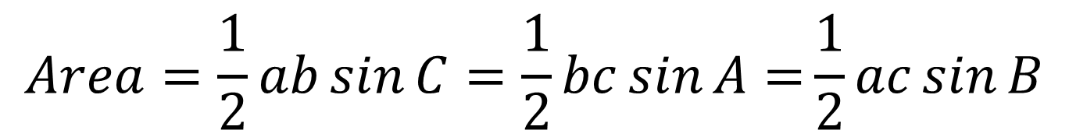
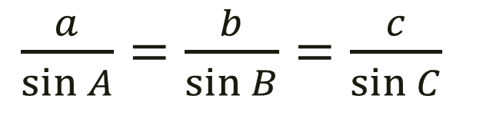
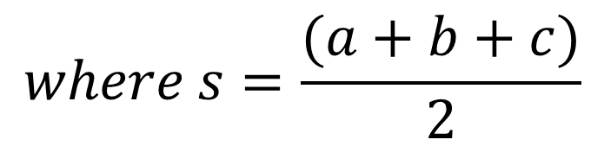
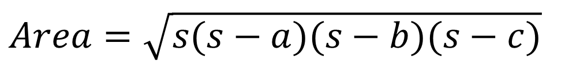
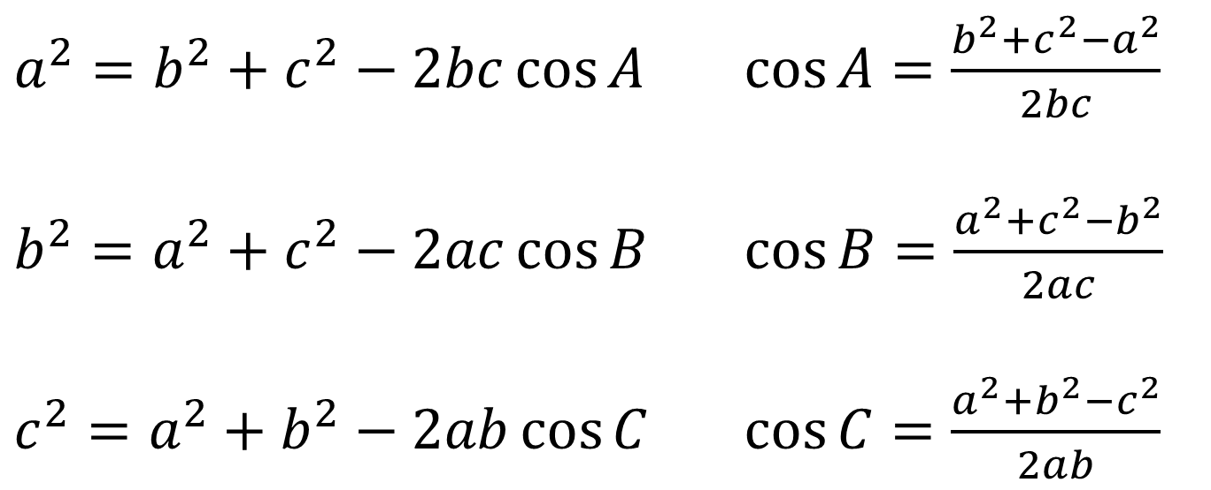
Law of sine
$$Area=\sqrt{s(s−a)(s−b)(s−c)}$$
$\frac{a}{\sin{A}}=\frac{b}{\sin{B}}=\frac{c}{\sin{C}}$
$$where s=\frac{(a+b+c)}{2}$$
$$Area=\frac{1}{2}ab\sin{C}=\frac{1}{2}bc\sin{A=}\frac{1}{2}ac\sin{B}$$
$a^{2}=b^{2}+c^{2}−2bc\cos{A}$ $\cos{A=\frac{b^{2}+c^{2}−a^{2}}{2bc}}$
$b^{2}=a^{2}+c^{2}−2ac\cos{B}$ $\cos{B=\frac{a^{2}+c^{2}−b^{2}}{2ac}}$
$c^{2}=a^{2}+b^{2}−2ab\cos{C}$ $\cos{C=\frac{a^{2}+b^{2}−c^{2}}{2ab}}$
Law of cosine

Slide 5
Bridge Project
You’ll be in groups of 2 – 4
This project will involve some research, drafting, constructing, and testing
Pick your groups wisely
Requirements:

